Slide 1


Flight Price Prediction
Submitted By:
Shahnawaz Hussain

Slide 2
ACKNOWLEDGMENT
I express my sincere gratitude to Flip Robo Technologies for giving me the opportunity to work on this project on Flight Price Prediction using machine learning algorithms. I acknowledge my indebtedness to the authors of the paper titled: “Airline ticket price and demand prediction: A survey” and the online article titled: “Trying to Predict Airfares When The Unpredictable Happens” for providing me with invaluable insights and knowledge of the various factors that determine the price of Flight tickets.

Slide 3
INTRODUCTION
Business Problem Framing
Anyone who has booked a flight ticket knows how unexpectedly the prices vary. The cheapest available ticket on a given flight gets more and less expensive over time. This usually happens as an attempt to maximize revenue based on –
Time of purchase patterns (making sure last-minute purchases are expensive)
Keeping the flight as full as they want it (raising prices on a flight which is filling up in order to reduce sales and hold back inventory for those expensive last-minute expensive purchases)
Therefore, a predictive model to accurately predict Air fares is required to be made.

Slide 4
INTRODUCTION
Conceptual Background of the Domain Problem
Predictive modelling, Regression algorithms are some of the machine learning techniques used for predicting Flight Ticket prices. Identifying various relevant attributes like Airline Brand, flight duration, source and destination etc are crucial for working on the project as they determine the valuation of air fare.

Slide 5
INTRODUCTION
Review of Literature
A Research paper titled: “Airline ticket price and demand prediction: A survey” by Juhar Ahmed Adella and online article titled: “Trying to Predict Airfares When The Unpredictable Happens” were reviewed and studied to gain insights into all the attributes that contribute to the pricing of flight tickets.
It is learnt that deterministic features like Airline Brand, flight number, departure dates, number of intermediate stops, week day of departure, number of competitors on route and aggregate features – which are based on collected historical data on minimum price, mean price, number of quotes on non-stop,1-stop and multi-stoppage flights are some the most important factors that determine the pricing of Flight Tickets.
Airline ticket price and demand prediction: A survey - ScienceDirect
Flight Price Predictor | American Express GBT (amexglobalbusinesstravel.com)

Slide 6
INTRODUCTION
Motivation for the Problem Undertaken
With airfares fluctuating frequently, knowing when to buy and when to wait for a better deal to come along is tricky. The fluctuation in prices is frequent and one has limited time to book the cheapest ticket as the prices keep varying due to constant manipulation by Airline companies. Therefore, it is necessary to work on a predictive model based on deterministic and aggregate feature data that would predict with good accuracy the most optimal Air fare for a particular destination, route and schedule.

Slide 7
Analytical Problem Framing
Mathematical/ Analytical Modelling of the Problem
Various Regression analysis techniques were used to build predictive models to understand the relationships that exist between Flight ticket price and Deterministic and Aggregate features of Air travel. The Regression analysis models were used to predict the Flight ticket price value for changes in Air travel deterministic and aggregate attributes. Regression modelling techniques were used in this Problem since Air Ticket Price data distribution is continuous in nature.
In order to forecast Flight Ticket price, predictive models such as ridge regression Model, Random Forest Regression model, Decision tree Regression Model, Support Vector Machine Regression model and Extreme Gradient Boost Regression model were used to describe how the values of Flight Ticket Price depended on the independent variables of various Air Fare attributes.

Slide 8
Analytical Problem Framing
Data Sources and their formats
The Dataset was compiled by scraping Data for various Air Fare attributes and Price from https://www.yatra.com/ and https://www.easemytrip.com/
The data was converted into a Pandas Data frame under various Feature and Label columns and saved as a .csv file.

Slide 9
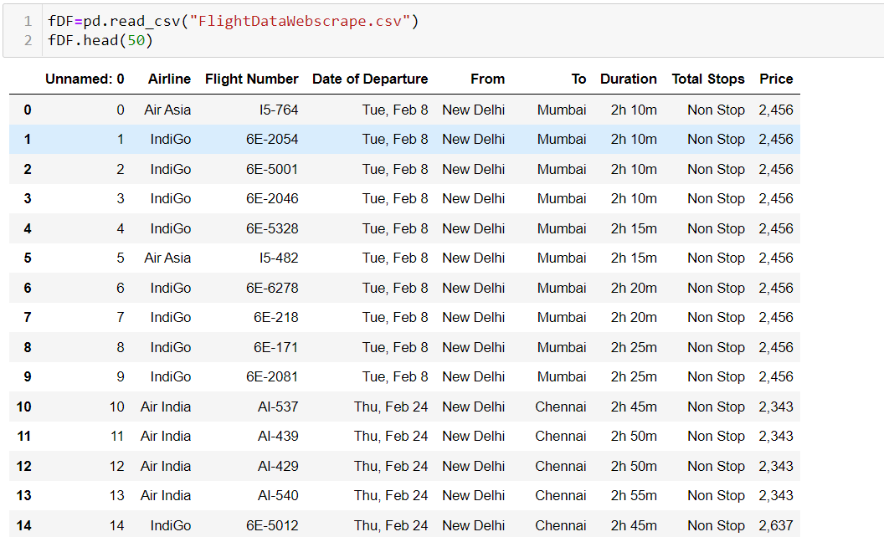

Slide 10
Analytical Problem Framing
Dataset Description
The Independent Feature columns are:
Airline: The name of the airline.
Flight Number: Number of Flight
Date of Departure: The date of the journey
From: The source from which the service begins
To: The destination where the service ends
Duration: Total duration of the flight
Total Stops: Total stops between the source and destination.

Slide 11
Analytical Problem Framing
Target / Label Column:
Price: The Price of the Ticket

Slide 12
Analytical Problem Framing
Data Pre-processing Done
Duplicate data elements in various columns: ‘Airline’,’From’,’To’, which had their starting letters in upper case and lower case were converted to data elements starting with uppercase letters.
Data in column ‘Price’ was converted to int64 data type.
Columns: Unnamed: 0(just a series of numbers) was dropped since it doesn't contribute to building a good model for predicting the target variable values.
The Date format of certain data elements in ‘Date of Departure’ was changed to match the general Date format of majority of the data elements of the column.

Slide 13
Analytical Problem Framing
Feature Engineering:
In order to better understand the relationships between Flight price and Air Fare attributes, ‘Day', 'Date’ and ‘Month’ columns were created based on data of existing column: ‘Date of Departure’.
The values in Column: ‘Duration’ were converted from Hours-Minutes format to minute format and the data type was converted to int64.

Slide 14
Analytical Problem Framing
Data Inputs- Logic- Output Relationships
The Datasets consist mainly of Int and Object data type variables. The relationships between the independent variables and dependent variable were analysed.

Slide 15
Hardware and Software Requirements and Tools Used
Hardware Used:
Device name LAPTOP-S0KG8J4C
Processor Intel(R) Core(TM) i5-1035G1 CPU @ 1.00GHz 1.20 GHz
Installed RAM 8.00 GB (7.74 GB usable)
Device ID A2B7913A-CE3E-40D0-9D50-7E5599B13EAD
Product ID 00327-36296-11993-AAOEM
System type 64-bit operating system, x64-based processor

Slide 16
Hardware and Software Requirements and Tools Used
Software Used:
Windows 11 Operating System
Anaconda Package and Environment Manager: Anaconda is a distribution of the Python and R programming languages for scientific computing, that aims to simplify package management and deployment. The distribution includes data-science packages suitable for Windows and provides a host of tools and environment for conducting Data Analytical and Scientific works. Anaconda provides all the necessary Python packages and libraries for Machine learning projects

Slide 17
Hardware and Software Requirements and Tools Used
Jupyter Notebook: The Jupyter Notebook is an open-source web application that allows data scientists to create and share documents that integrate live code, equations, computational output, visualizations, and other multimedia resources, along with explanatory text in a single document.
Python3: It is open source, interpreted, high level language and provides great approach for object-oriented programming. It is one of the best languages used for Data Analytics And Data science projects/application. Python provides numerous libraries to deal with mathematics, statistics and scientific function.

Slide 18
Hardware and Software Requirements and Tools Used
Python Libraries used:
Pandas: For carrying out Data Analysis, Data Manipulation, Data Cleaning etc
NumPy: For performing a variety of operations on the datasets.
matplotlib.pyplot, Seaborn: For visualizing Data and various relationships between Feature and Label Columns
Scipy: For performing operations on the datasets
Stats models: For performing statistical analysis
Sklearn for Modelling Machine learning algorithms, Data Encoding, Evaluation metrics, Data Transformation, Data Scaling, Component analysis, Feature selection etc.

Slide 19
Exploratory Data Analysis
Visualizations
Barplots,Distplots,Boxplots,Countplots,lineplots were used to visualise the data of all the columns and their relationships with Target variable.

Slide 20
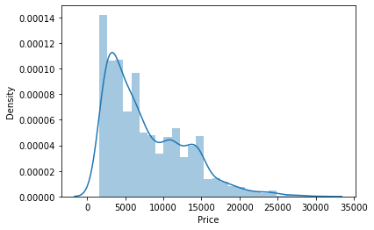
Exploratory Data Analysis
Univariate Analysis
Analysing the Target Variable

Slide 21
Exploratory Data Analysis
From the graph above it is observed that the Price data forms a continuous distribution with mean of 7748.33 and tails of from 15000 mark and the distribution is skewed.

Slide 22
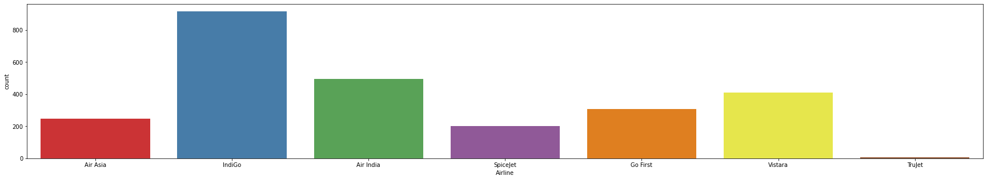
Exploratory Data Analysis
Analysing the Feature Columns

Slide 23
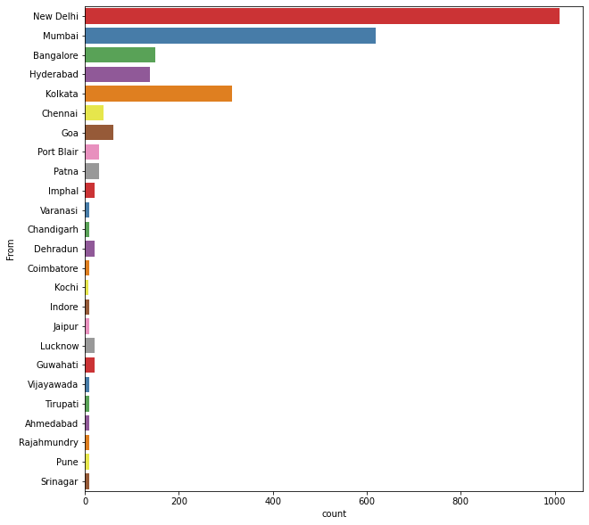
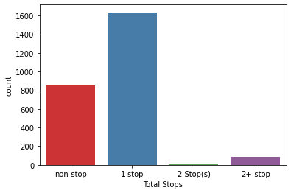

Slide 24
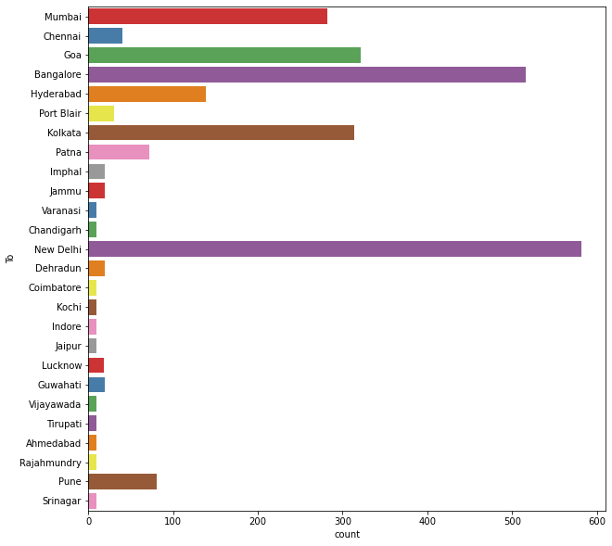

Slide 25
Exploratory Data Analysis
Following observations are made from graphs above:
IndiGo has the highest number of flights followed by Air India and Vistara
Highest number of flights are from Delhi followed by Mumbai, Kolkata, Bangalore and Hyderabad
New Delhi is the most popular destination followed by Bangalore, Goa, Kolkata and Mumbai
Highest number of flights have only 1 stop between source and destination while 2nd highest number of flights are non stop

Slide 26
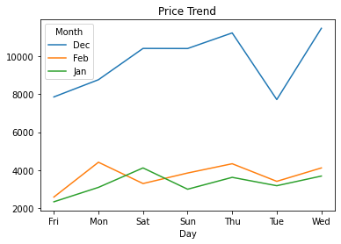
Exploratory Data Analysis
Bivariate Analysis
Interpreting Relationship between Dependent Variable and Independent Variable Columns
Analysing Relationship between Day, Month columns and Price

Slide 27
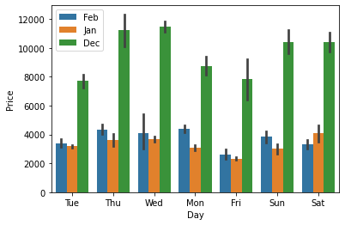
Exploratory Data Analysis

Slide 28
Exploratory Data Analysis
Following observations are made from graphs above:
On an average, there is a steady decline in Flight price from December to February, with the prices being lowest in January.
Flight Prices increase on an average, as the day of departure gets nearer.
Flight Ticket prices are the highest on Thursdays, Mondays and during the weekend on an average.

Slide 29
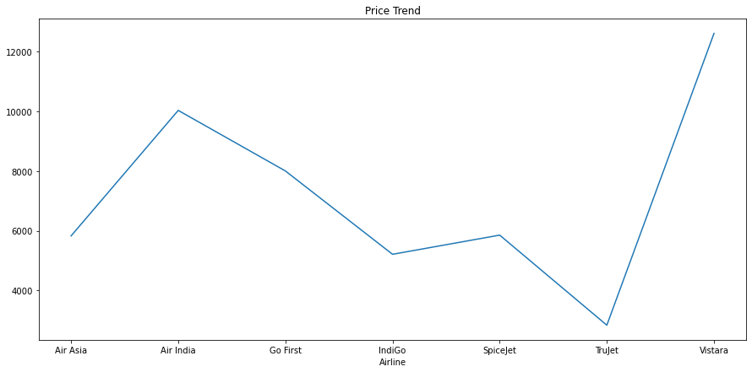
Exploratory Data Analysis
Analysing Relationship between Airlines, Flight Duration and Price

Slide 30
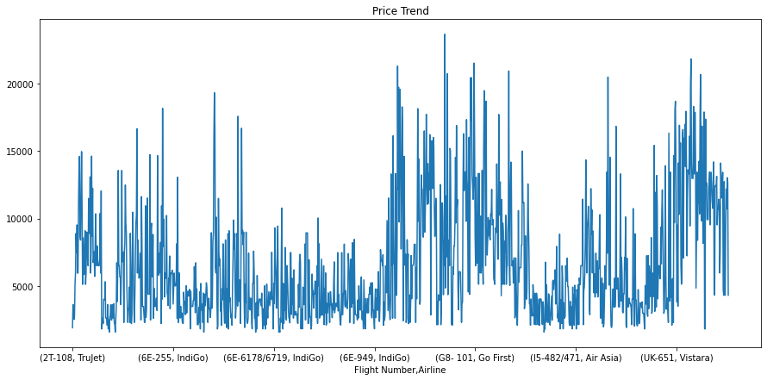
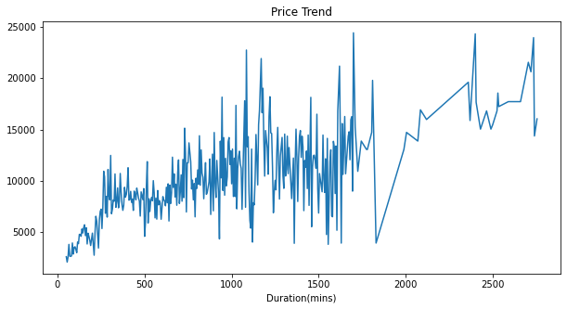

Slide 31
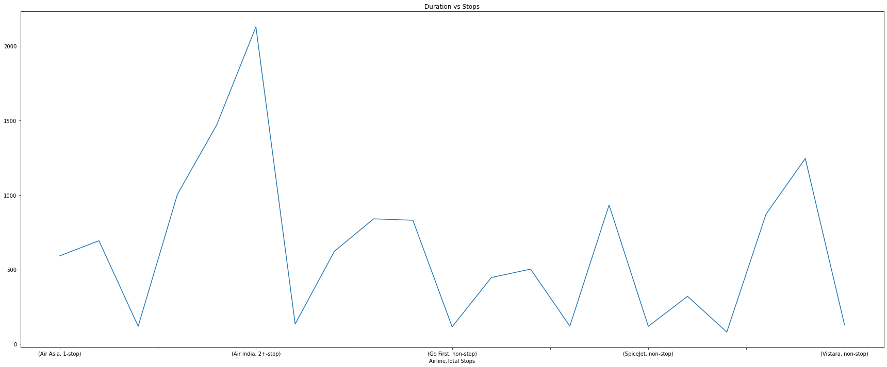

Slide 32
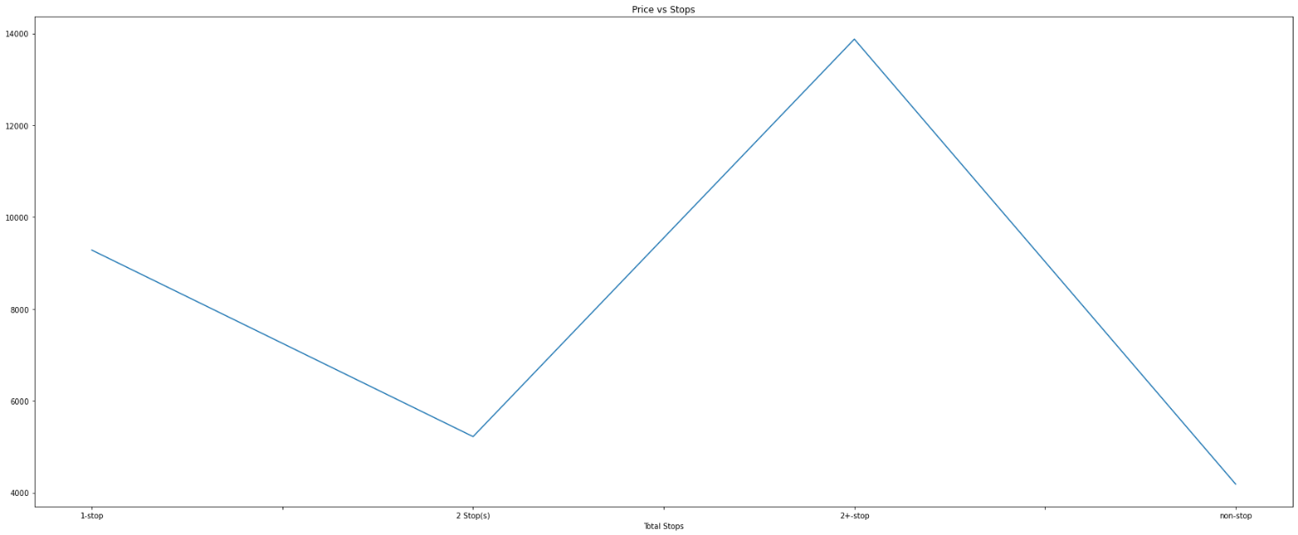

Slide 33
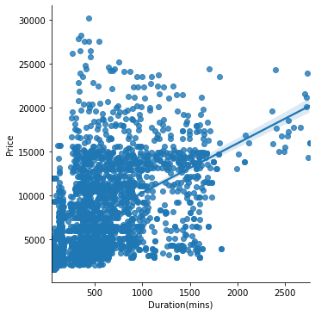

Slide 34
Exploratory Data Analysis
Following Observation is made from graphs above:
Trujet, Indigo, SpiceJet and Air Asia offer air tickets at the most affordable prices on average, whereas Vistara, Air India are the most expensive on average.
It can be observed that Number of Stops impact the travel time of Airlines.
It can be observed that Number of Stops impact the Air Ticket Pricing of Airlines.
There is a linear relationship between Price and flight duration.

Slide 35
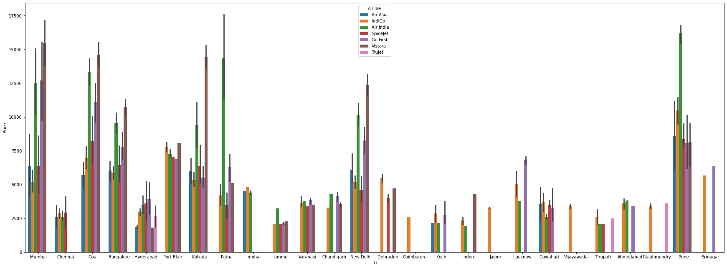
Exploratory Data Analysis
Multivariate Analysis

Slide 36
Exploratory Data Analysis
Following Observations are made from graphs above:
There is a linear relationship between Price and flight duration.
IndiGo, Air Asia and SpiceJet provide most affordable Airtickets to the destinations.

Slide 37
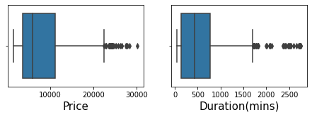
Exploratory Data Analysis
Checking for Outliers
There are considerable outliers in the columns.
Outliers were Removed using Z score method which resulted in a total data loss of 1.00%, which is within acceptable range.

Slide 38
Exploratory Data Analysis
Data Normalization
Data in Column ‘Duration(mins) was normalized using Power Transformer technique.

Slide 39
Exploratory Data Analysis
Finding Correlation between Feature and Target columns

Slide 40
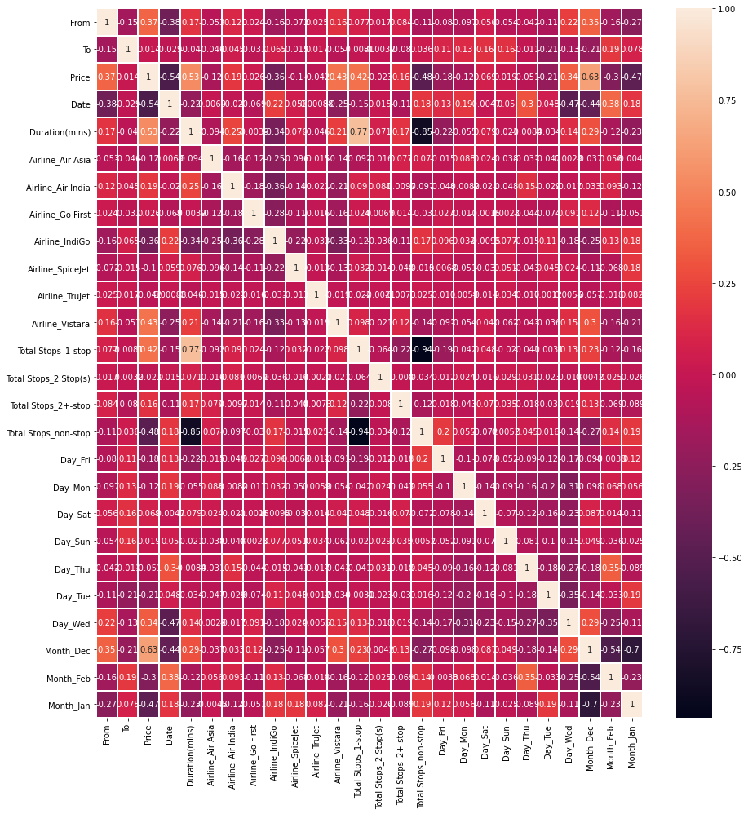

Slide 41
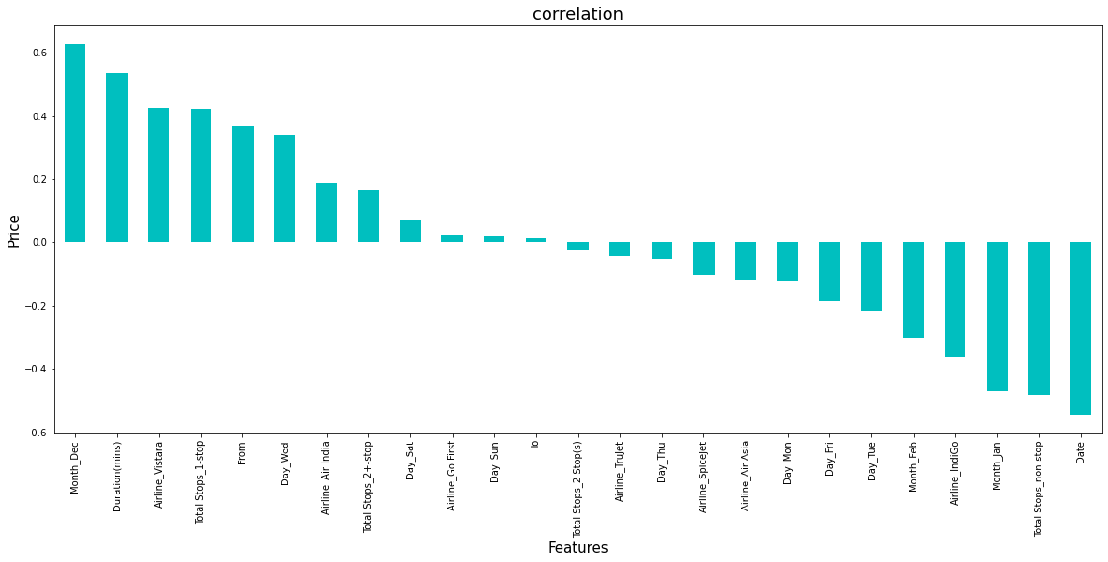
Exploratory Data Analysis

Slide 42
Exploratory Data Analysis
It is observed that Month_Dec, Duration(mins), Airline_Vistara,Total Stops_1-stop and From have the highest positive correlation with Price, while Date,Total Stops_non-stop,Month_Jan,Airline_IndiGo have the highest negative correlation with Price.

Slide 43
Model/s Development and Evaluation
Feature Selection
Features were first checked for presence of multicollinearity and then based on respective ANOVA f-score values, the feature columns were selected that would best predict the Target variable, to train and test machine learning models.
Using SelectKBest and f_classif for measuring the respective ANOVA f-score values of the columns, the best features were selected. Using StandardScaler, the features were scaled by resizing the distribution values so that mean of the observed values in each feature column is 0 and standard deviation is 1.
From sklearn.model_selection’s train_test_split, the data was divided into train and test data. Training data comprised 75% of total data where as test data comprised 25% based on the best random state that would result in best model accuracy.

Slide 44
Model/s Development and Evaluation
The model algorithms used were as follows:
Ridge
DecisionTreeRegressor
XGBRegressor
RandomForestRegressor:
Support Vector Regressor:

Slide 45
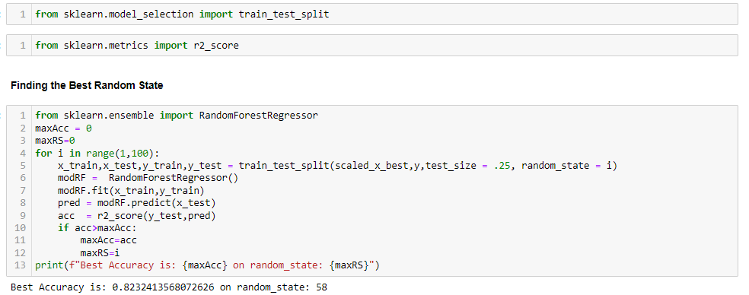
Model/s Development and Evaluation
Regression Model Building
Best random state was determined to be 58

Slide 46
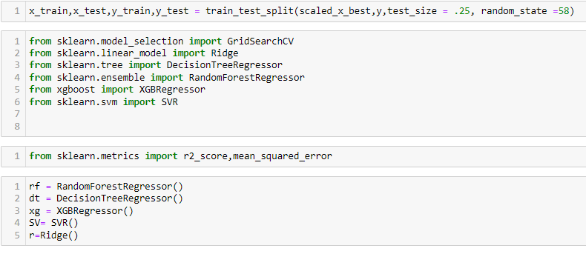

Slide 47
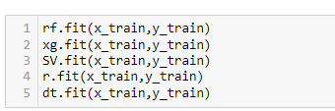
Model/s Development and Evaluation
Training The Models

Slide 48
Model/s Development and Evaluation
Analysing Accuracy of The Models
Mean Squared Error and Root Mean Squared Error metrics were used to evaluate the Model performance. The advantage of MSE and RMSE being that it is easier to compute the gradient. As, we take square of the error, the effect of larger errors become more pronounced than smaller error, hence the model can now focus more on the larger errors.

Slide 49
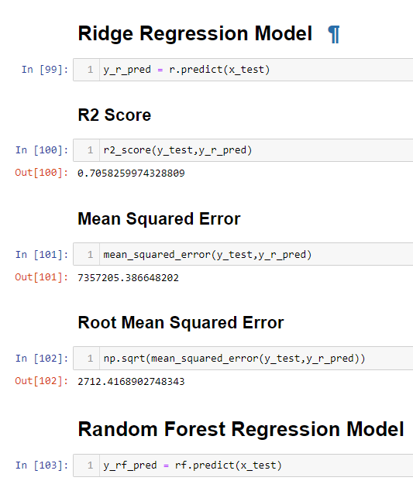
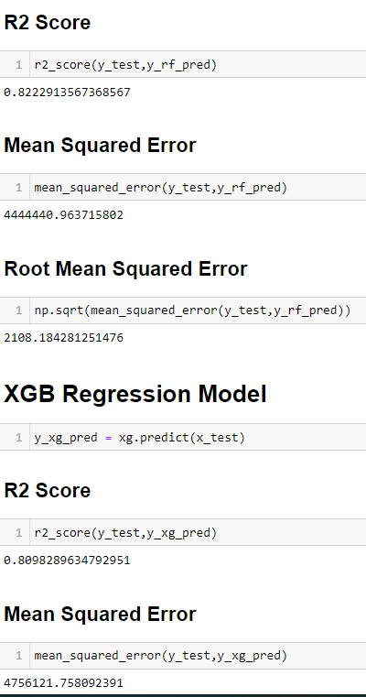
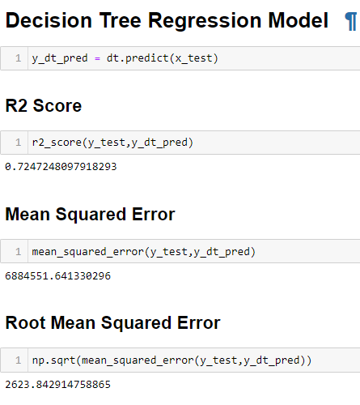
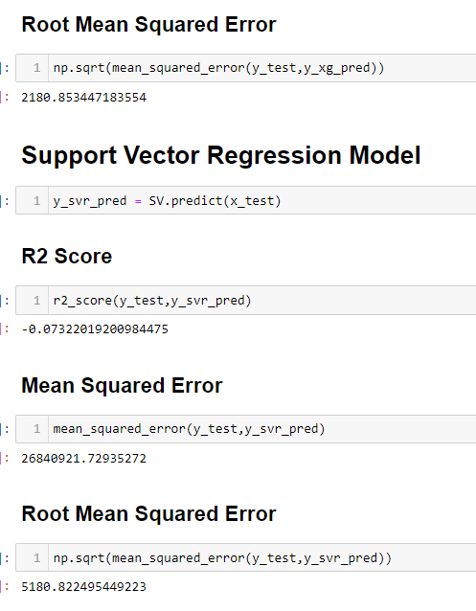

Slide 50
Model/s Development and Evaluation
Using cross-validation, there are high chances that we can detect over-fitting with ease. Model Cross Validation scores were then obtained for assessing how the statistical analysis generalises to an independent data set. The models were evaluated by training several models on subsets of the available input data and evaluating them on the complementary subset of the data.

Slide 51
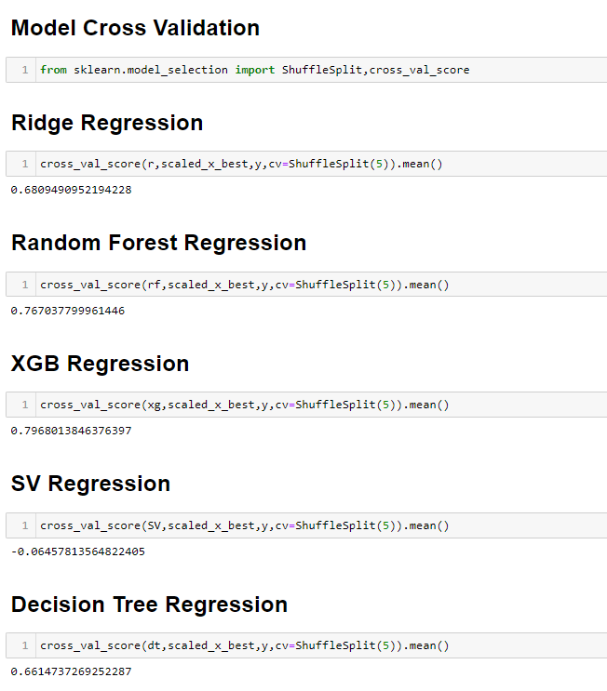

Slide 52
Model/s Development and Evaluation
Interpretation of the Results
Based on comparing Accuracy Score results with Cross Validation results, it is determined that Random Forest Regressor is the best model. It also has the lowest Root Mean Squared Error score.

Slide 53
Model/s Development and Evaluation
Hyper Parameter Tuning
GridSearchCV was used for Hyper Parameter Tuning of the Random Forest Regressor model. Based on the input parameter values and after fitting the train datasets The Random Forest Regressor model was further tuned based on the parameter values yielded from GridsearchCV.
The Random Forest Regressor model displayed an accuracy of 83.55%. This model was then tested using a scaled Test Dataset.
The model performed with good amount of accuracy.

Slide 54
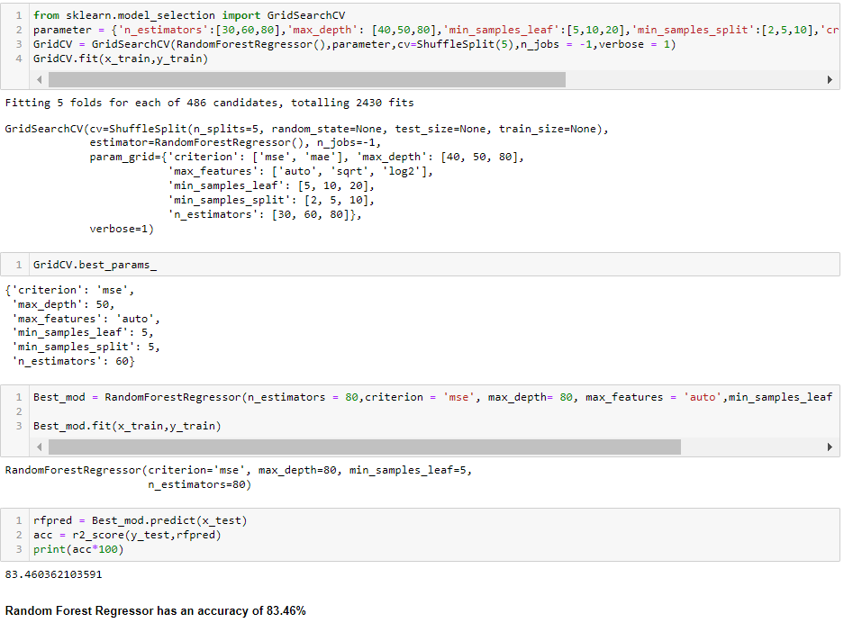

Slide 55
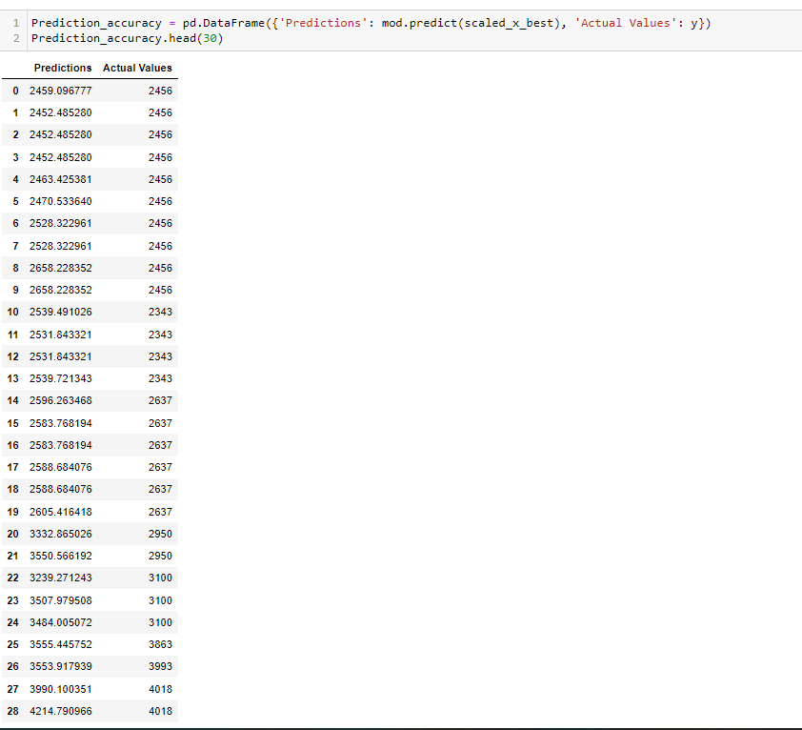

Slide 56
Model/s Development and Evaluation
In summary, Based on the visualizations of the feature-column relationships, it is determined that, Features like Source,month,Duration,Total Stops,Airline,Date are some of the most important features to predict the label values. Random Forest Regressor Performed the best out of all the models that were tested. It also worked well with the outlier handling.

Slide 57
CONCLUSION
Key Findings and Conclusions of the Study and Learning Outcomes with respect to Data Science
Based on the in-depth analysis of the Flight Price Prediction Project, The Exploratory analysis of the datasets, and the analysis of the Outputs of the models the following observations are made:
Air Fare attributes like Date,Month,Duration,Total Stops etc play a big role in influencing the used Flight price.
Airline Brand also has a very important role in determining the used Flight Ticket price.

Slide 58
CONCLUSION
Various plots like Barplots,Countplots and Lineplots helped in visualising the Feature-label relationships which corroborated the importance of Air Fare features and attributes for estimating Flight Ticket Prices.
Due to the Training dataset being very small, only very small amount of the outliers was removed to ensure proper training of the models.
Therefore, Random Forest Regressor, which uses averaging to improve the predictive accuracy and controls over-fitting. performed well despite having to work on small dataset and produced good predictions that can be understood easily.

Slide 59
Learning Outcomes of the Study in respect of Data Science
Data cleaning was a very important step in removing plenty of anomalous data from the huge dataset that was provided.
Visualising data helped identify outliers and the relationships between target and feature columns as well as analysing the strength of correlation that exists between them.

Slide 60
Limitations:
Limitations of this work and Scope for Future Work
A small dataset to work with posed a challenge in building highly accurate models. This project also relied heavily on historical data and was unable to account for various other factors that influence demand and ticket pricing like pandemic status affecting demand, government regulations on air travel, shifting in routes, weather conditions, etc.
Most airline companies also do no publicly make available their ticket pricing strategies, which makes gathering price and air fare related data sets using web scraping the only means to build a dataset for building predicting models.
Availability of more features and a larger dataset would help build better models.

